Slide 1
Image Processing

Slide 2
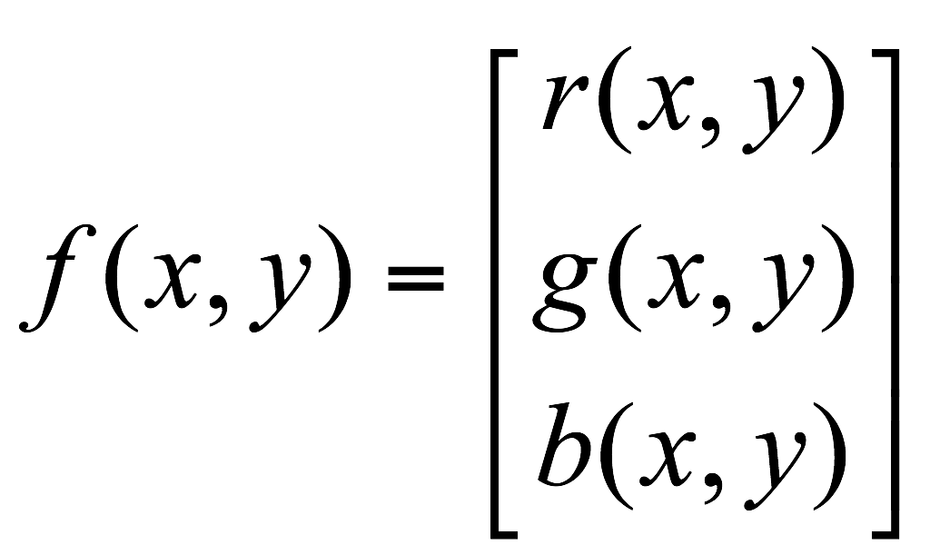
What is an image?
We can think of an image as a function, f, from R² to R:
f( x, y ) gives the intensity at position ( x, y )
Realistically, we expect the image only to be defined over a rectangle, with a finite range:
f: [a,b]x[c,d] → [0,1]
A color image is just three functions pasted together. We can write this as a “vector-valued” function:
Notes:
As opposed to [0..255]

Slide 3
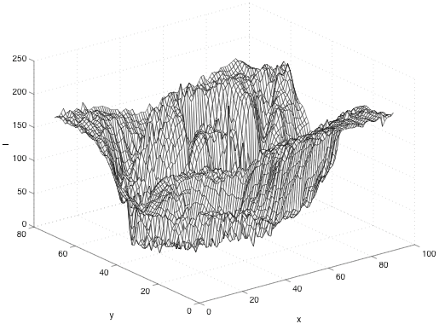
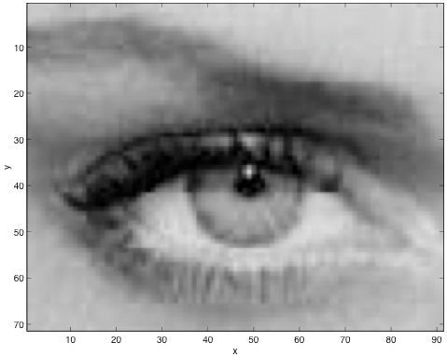
Image
Brightness values
I(x,y)

Slide 4


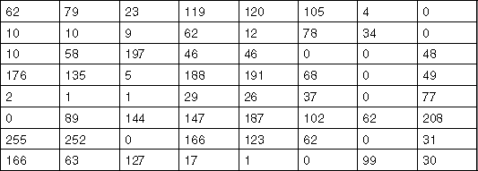
What is a digital image?
In computer vision we usually operate on digital (discrete) images:
Sample the 2D space on a regular grid
Quantize each sample (round to nearest integer)
If our samples are Δ apart, we can write this as:
f[i ,j] = Quantize{ f(i Δ, j Δ) }
The image can now be represented as a matrix of integer values

Slide 5
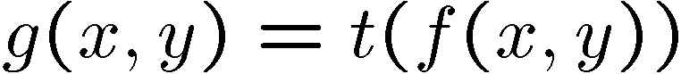
Image Processing
An image processing operation typically defines a new image g in terms of an existing image f.
We can transform either the domain or the range of f.
Range transformation:
What kinds of operations can this perform?
Some operations preserve the range but change the domain of f :
What kinds of operations can this perform?
Notes:
Use photoshop to make something grayscale

Slide 6
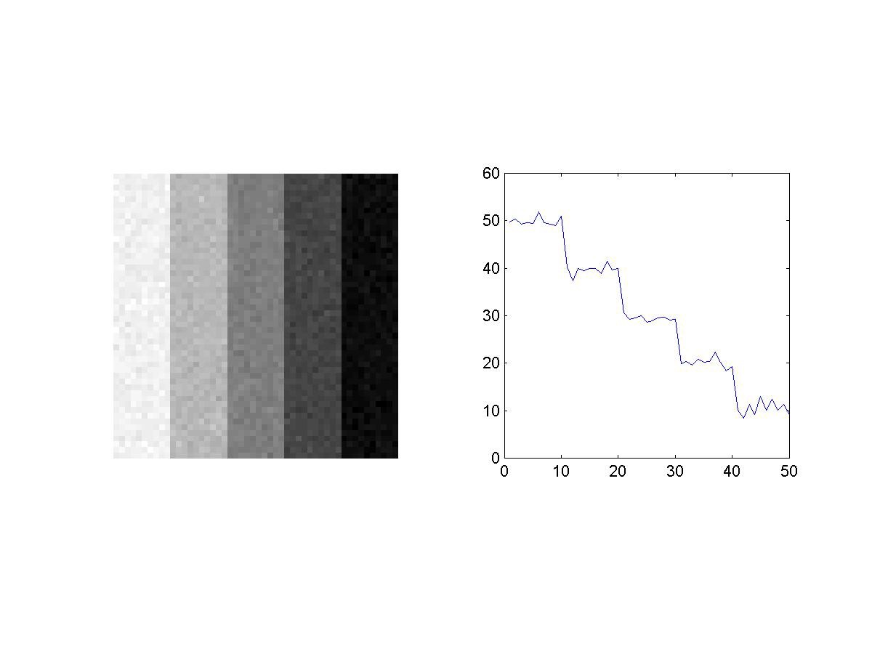
Filtering and Image Features
Given a noisy image
How do we reduce noise ?
How do we find useful features ?
Filtering
Point-wise operations
Edge detection

Slide 7
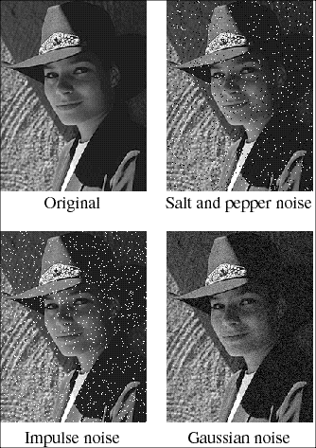
Noise
Image processing is useful for noise reduction...
Common types of noise:
Salt and pepper noise: contains random occurrences of black and white pixels
Impulse noise: contains random occurrences of white pixels
Gaussian noise: variations in intensity drawn from a Gaussian normal distribution
Notes:
Salt and pepper and impulse noise can be due to transmission errors (e.g., from deep space probe), dead CCD pixels, specks on lens
We’re going to focus on Gaussian noise first.
If you had a sensor that was a little noisy and measuring the same thing over and over, how would you reduce the noise?

Slide 8
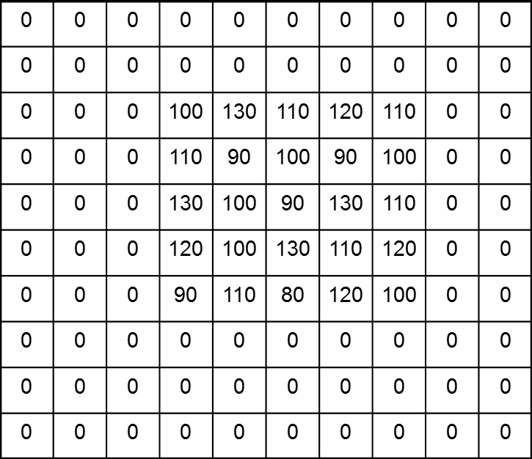
Practical noise reduction
How can we “smooth” away noise in a single image?
Notes:
Replace each pixel with the average of a kxk window around it

Slide 9
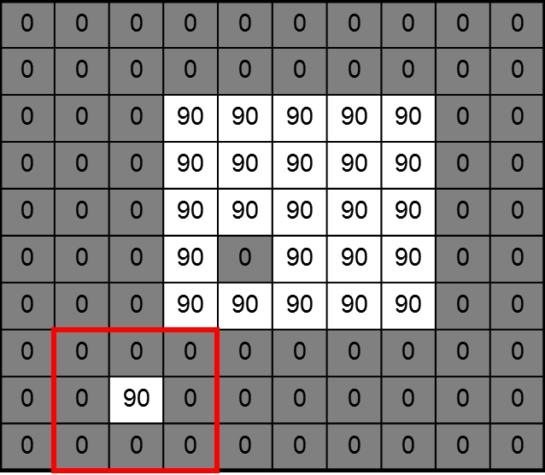
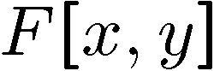
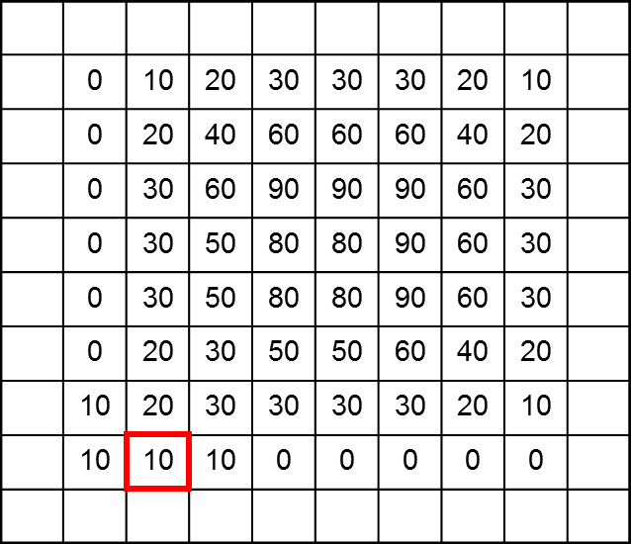
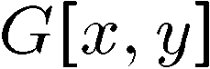
Mean filtering (average over a neighborhood)
Notes:
Replace each pixel with the average of a kxk window around it
What happens if we use a larger filter window?

Slide 10
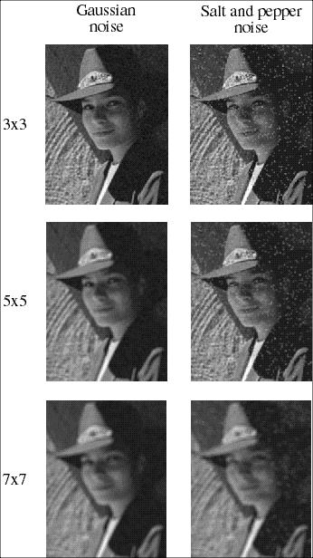
Effect of mean filters
Notes:
Demo with photoshop

Slide 11
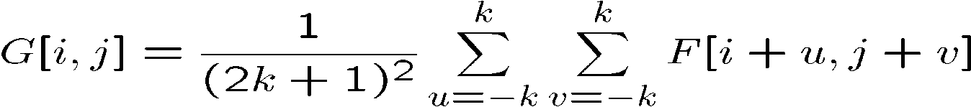
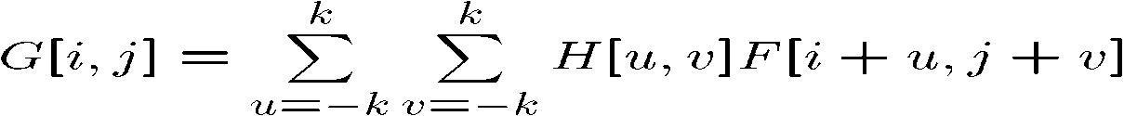
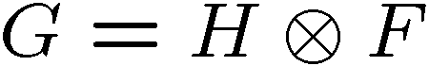
Cross-correlation filtering
Let’s write this down as an equation. Assume the averaging window is (2k+1)x(2k+1):
We can generalize this idea by allowing different weights for different neighboring pixels:
This is called a cross-correlation operation and written:
H is called the “filter,” “kernel,” or “mask.”

Slide 12
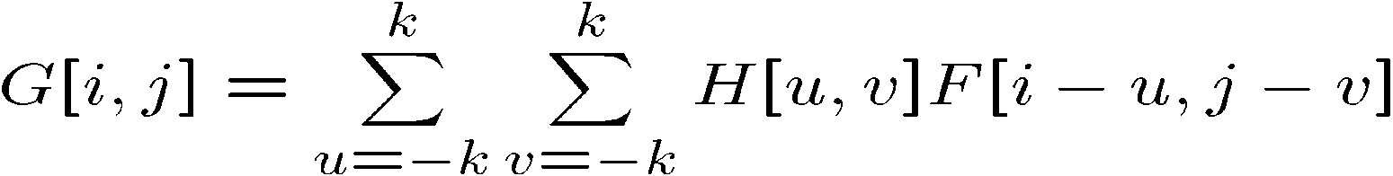

Convolution
A convolution operation is a cross-correlation where the filter is flipped both horizontally and vertically before being applied to the image:
It is written:
Suppose H is a Gaussian or mean kernel. How does convolution differ from cross-correlation?
Notes:
They are the same for filters that have both horizontal and vertical symmetry.

Slide 13

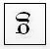
Convolution
F
F
Convention: kernel is “flipped”
G
MATLAB functions: conv2, filter2, imfilter

Slide 14
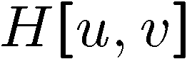
Mean kernel
What’s the kernel for a 3x3 mean filter?
0 | 0 | 0 | 0 | 0 | 0 | 0 | 0 | 0 | 0
0 | 0 | 0 | 0 | 0 | 0 | 0 | 0 | 0 | 0
0 | 0 | 0 | 90 | 90 | 90 | 90 | 90 | 0 | 0
0 | 0 | 0 | 90 | 90 | 90 | 90 | 90 | 0 | 0
0 | 0 | 0 | 90 | 90 | 90 | 90 | 90 | 0 | 0
0 | 0 | 0 | 90 | 0 | 90 | 90 | 90 | 0 | 0
0 | 0 | 0 | 90 | 90 | 90 | 90 | 90 | 0 | 0
0 | 0 | 0 | 0 | 0 | 0 | 0 | 0 | 0 | 0
0 | 0 | 90 | 0 | 0 | 0 | 0 | 0 | 0 | 0
0 | 0 | 0 | 0 | 0 | 0 | 0 | 0 | 0 | 0
Notes:
ones, divide by 9

Slide 15
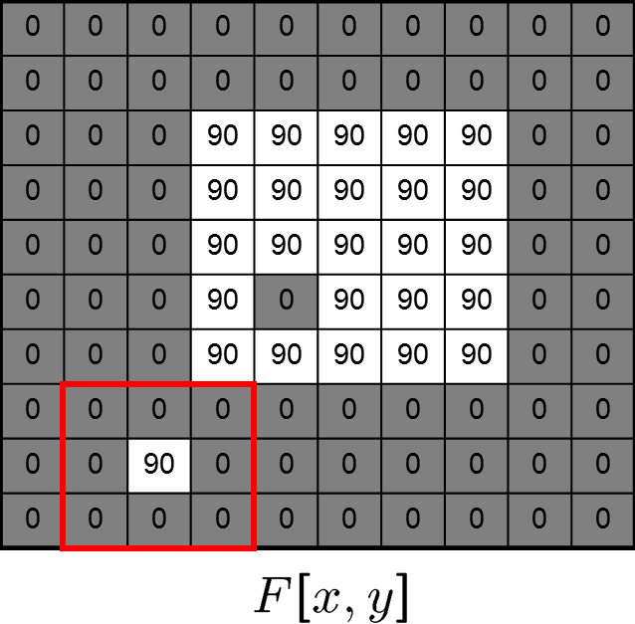
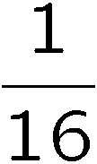
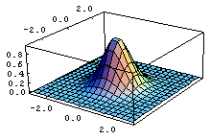
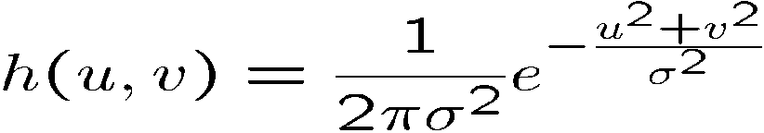
Gaussian Filtering
A Gaussian kernel gives less weight to pixels further from the center of the window
This kernel is an approximation of a Gaussian function:
1 | 2 | 1
2 | 4 | 2
1 | 2 | 1

Slide 16
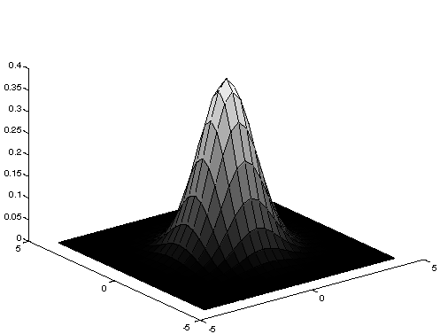
Gaussian Averaging
Rotationally symmetric.
Weights nearby pixels more than distant ones.
This makes sense as probabalistic inference.
A Gaussian gives a good model of a fuzzy blob

Slide 17
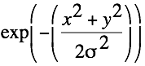
An Isotropic Gaussian
The picture shows a smoothing kernel proportional to
(which is a reasonable model of a circularly symmetric fuzzy blob)

Slide 18
Matlab: filtering
Demo use in matlab

Slide 19
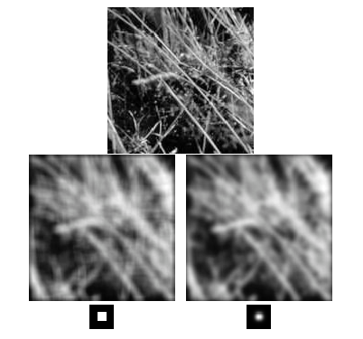
Mean vs. Gaussian filtering

Slide 20
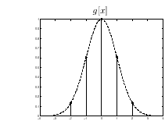
How big should the mask be?
The std. dev of the Gaussian σ determines the amount of smoothing.
The samples should adequately represent a Gaussian
For a 98.76% of the area, we need
m = 5σ
5.(1/σ) ≤ 2π ⇒ σ ≥ 0.796, m ≥5
5-tap filter
g[x] = [0.136, 0.6065, 1.00, 0.606, 0.136]

Slide 21
The size of the mask
Bigger mask:
more neighbors contribute.
smaller noise variance of the output.
bigger noise spread.
more blurring.
more expensive to compute.
In Matlab function conv, conv2

Slide 22
Gaussian filters
Remove “high-frequency” components from the image (low-pass filter)
Convolution with self is another Gaussian
So can smooth with small-σ kernel, repeat, and get same result as larger-σ kernel would have
Convolving two times with Gaussian kernel with std. dev. σ
is same as convolving once with kernel with std.
dev. σ 2
Separable kernel
Factors into product of two 1D Gaussians
Source: K. Grauman

Slide 23
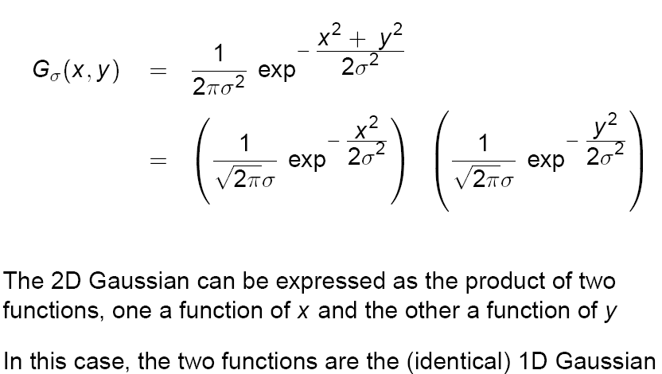
Separability of the Gaussian filter
Source: D. Lowe

Slide 24
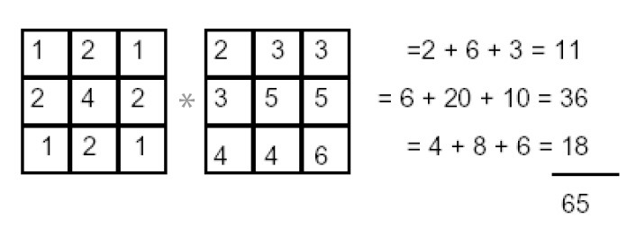
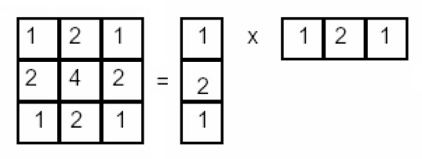
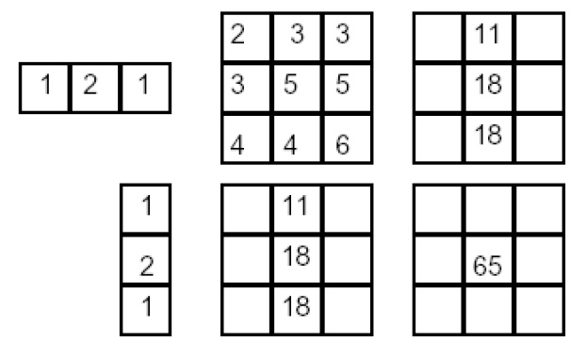
Separability example
2D convolution (center location only)
The filter factors into a product of 1D filters:
Perform convolution along rows:
*
=
* =
Followed by convolution along the remaining column:
Source: K. Grauman

Slide 25
Efficient Implementation
Both, the BOX filter and the Gaussian filter are separable:
First convolve each row with a 1D filter
Then convolve each column with a 1D filter.

Slide 26
Linear Shift-Invariance
A tranform T{} is
Linear if:
T(a g(x,y)+b h(x,y)) = a T{g(x,y)} + b T(h(x,y))
Shift invariant if:
Given T(i(x,y)) = o(x,y)
T{i(x-x0, y- y0)} = o(x-x0, y-y0)

Slide 27
Median filters
A Median Filter operates over a window by selecting the median intensity in the window.
What advantage does a median filter have over a mean filter?
Is a median filter a kind of convolution?
Median filter is non linear
Notes:
Better at salt’n’pepper noise
Not convolution: try a region with 1’s and a 2, and then 1’s and a 3

Slide 28
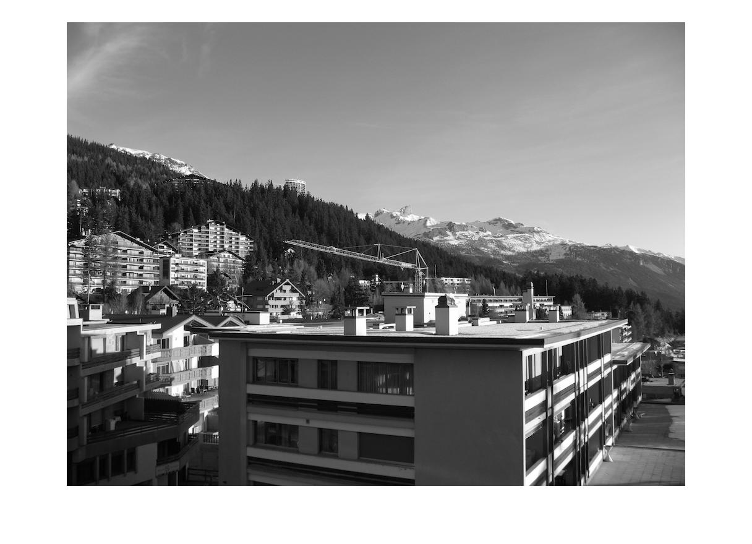


Median filter

Slide 29
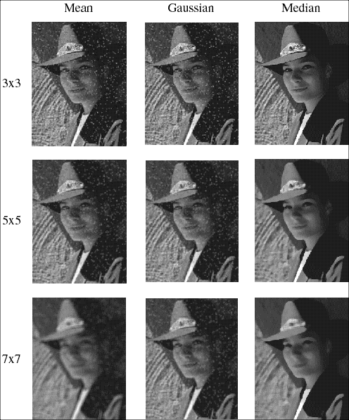
Comparison: salt and pepper noise

Slide 30
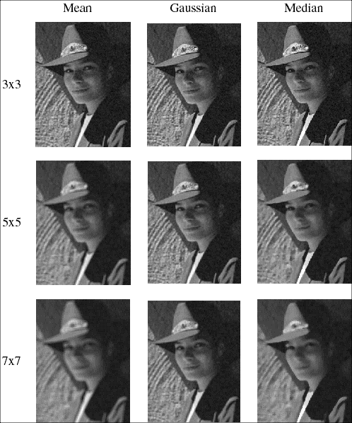
Comparison: Gaussian noise

Slide 31
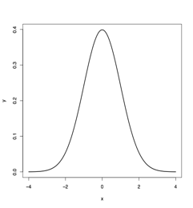
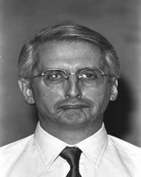
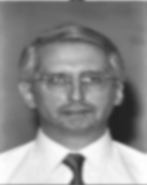



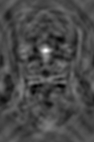
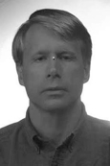
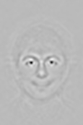




Convolution
Gaussian

Slide 32
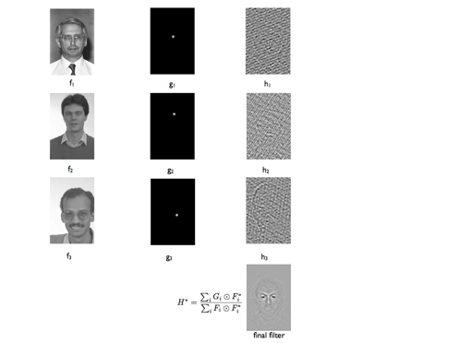
MOSSE* Filter
Bolme et al. CVPR, 2010

Slide 33




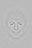
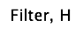
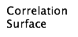

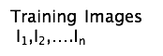


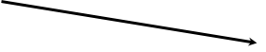


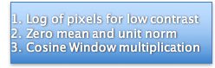
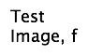
Face Localization

Slide 34
Edge detection as filtering

Slide 35
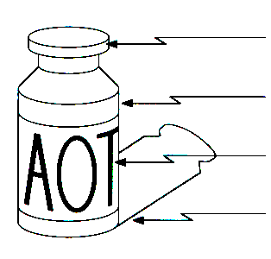
Origin of Edges
surface normal discontinuity
depth discontinuity
surface color discontinuity
illumination discontinuity
Edges are caused by a variety of factors

Slide 36





Edge detection (1D)
F(x)
Edge= sharp variation
x
F ’(x)
Large first derivative
x

Slide 37
Edge is Where Change Occurs
Change is measured by derivative in 1D
Biggest change, derivative has maximum magnitude
Or 2nd derivative is zero.

Slide 38

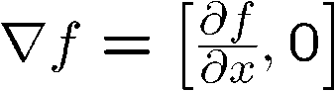




Image gradient
The gradient of an image:
The gradient points in the direction of most rapid change in intensity
The gradient direction is given by:
How does this relate to the direction of the edge?
The edge strength is given by the gradient magnitude

Slide 39


The discrete gradient
How can we differentiate a digital image f[x,y]?
Option 1: reconstruct a continuous image, then take gradient
Option 2: take discrete derivative (finite difference)
How would you implement this as a cross-correlation?

Slide 40



The Sobel operator
Better approximations of the derivatives exist
The Sobel operators below are very commonly used
-1 | 0 | 1
-2 | 0 | 2
-1 | 0 | 1
1 | 2 | 1
0 | 0 | 0
-1 | -2 | -1
The standard defn. of the Sobel operator omits the 1/8 term
doesn’t make a difference for edge detection
the 1/8 term is needed to get the right gradient value, however

Slide 41



Edge Detection Using Sobel Operator
-1
0
1
*
-2
0
2
=
-1
0
1
horizontal edge detector
-1
-2
-1
*
0
0
0
=
1
2
1
vertical edge detector

Slide 42

Gradient operators
(a): Roberts’ cross operator (b): 3x3 Prewitt operator
(c): Sobel operator (d) 4x4 Prewitt operator

Slide 43




Effects of noise
Consider a single row or column of the image
Plotting intensity as a function of position gives a signal
Where is the edge?

Slide 44





Solution: smooth first
Where is the edge?
Look for peaks in

Slide 45




Derivative theorem of convolution
This saves us one operation:

Slide 46


Derivative of Gaussian filter
* [1 -1] =
Is this filter separable?

Slide 47


Derivative of Gaussian filter
x-direction
y-direction
Which one finds horizontal/vertical edges?

Slide 48




Laplacian of Gaussian
Consider
Laplacian of Gaussian
operator
Where is the edge?
Zero-crossings of bottom graph

Slide 49






2D edge detection filters
Laplacian of Gaussian
Gaussian
derivative of Gaussian
is the Laplacian operator:

Slide 50



Tradeoff between smoothing and localization
1 pixel
3 pixels
7 pixels
Smoothed derivative removes noise, but blurs edge. Also finds edges at different “scales”.
Source: D. Forsyth

Slide 51

Implementation issues
The gradient magnitude is large along a thick “trail” or “ridge,” so how do we identify the actual edge points?
How do we link the edge points to form curves?
Source: D. Forsyth
Notes:
Figures show gradient magnitude of zebra at two different scales

Slide 52
Optimal Edge Detection: Canny
Assume:
Linear filtering
Additive iid Gaussian noise
Edge detector should have:
Good Detection. Filter responds to edge, not noise.
Good Localization: detected edge near true edge.
Single Response: one per edge.

Slide 53
Optimal Edge Detection: Canny (continued)
Optimal Detector is approximately Derivative of Gaussian.
Detection/Localization trade-off
More smoothing improves detection
And hurts localization.
This is what you might guess from (detect change) + (remove noise)

Slide 54
Canny edge detector
Filter image with derivative of Gaussian
Find magnitude and orientation of gradient
Non-maximum suppression:
Thin multi-pixel wide “ridges” down to single pixel width
Linking and thresholding (hysteresis):
Define two thresholds: low and high
Use the high threshold to start edge curves and the low threshold to continue them
MATLAB: edge(image, ‘canny’)
Source: D. Lowe, L. Fei-Fei

Slide 55

The Canny edge detector
original image (Lena)

Slide 56

The Canny edge detector
norm of the gradient

Slide 57

The Canny edge detector
thresholding

Slide 58

The Canny edge detector
thinning
(non-maximum suppression)

Slide 59

Non-maximum suppression
Check if pixel is local maximum along gradient direction
requires checking interpolated pixels p and r

Slide 60

Predicting
the next
edge point
Assume the marked point is an edge point. Then we construct the tangent to the edge curve (which is normal to the gradient at that point) and use this to predict the next points (here either r or s).
(Forsyth & Ponce)

Slide 61
Hysteresis
Check that maximum value of gradient value is sufficiently large
drop-outs? use hysteresis
use a high threshold to start edge curves and a low threshold to continue them.

Slide 62




Canny Edge Detection (Example)
gap is gone
Original image
Strong + connected weak edges
Strong edges
only
Weak edges
courtesy of G. Loy

Slide 63






Effect of σ (Gaussian kernel size)
original
Canny with
Canny with
The choice of depends on desired behavior
large detects large scale edges
small detects fine features

Slide 64


Scale
Smoothing
Eliminates noise edges.
Makes edges smoother.
Removes fine detail.
(Forsyth & Ponce)
Notes:
Figures show gradient magnitude of zebra at two different scales

Slide 65


Slide 66

fine scale
high
threshold

Slide 67

coarse
scale,
high
threshold

Slide 68

coarse
scale
low
threshold

Slide 69



Scale space (Witkin 83)
first derivative peaks
larger
Gaussian filtered signal
Properties of scale space (w/ Gaussian smoothing)
edge position may shift with increasing scale (σ)
two edges may merge with increasing scale
an edge may not split into two with increasing scale

Slide 70
Filters are templates
Applying a filter at some point can be seen as taking a dot-product between the image and some vector
Filtering the image is a set of dot products
Insight
filters look like the effects they are intended to find
filters find effects they look like
Computer Vision - A Modern
Approach Set: Linear Filters Slides by D.A. Forsyth

Slide 71

Filter Bank
Leung & Malik, Representing and Recognizing the Visual Apperance using 3D Textons, IJCV 2001

Slide 72






Learning to detect boundaries
image
human segmentation
gradient magnitude
Berkeley segmentation database: http://www.eecs.berkeley.edu/Research/Projects/CS/vision/grouping/segbench/

Slide 73

pB boundary detector
Martin, Fowlkes, Malik 2004: Learning to Detection Natural Boundaries…
http://www.eecs.berkeley.edu/Research/Projects/CS/vision/grouping/papers/mfm-pami-boundary.pdf
Figure from Fowlkes

Slide 74

pB Boundary Detector
- Estimate Posterior probability of boundary passing through centre point based on local patch based features
- Using a Supervised Learning based framework

Slide 75



Results
Pb (0.88)
Human (0.95)

Slide 76



Results
Pb
Pb (0.88)
Global Pb
Human
Human (0.96)

Slide 77
Corners contain more edges than lines.
Corner detection
A point on a line is hard to match.

Slide 78
Corners contain more edges than lines.
A corner is easier

Slide 79
Edge Detectors Tend to Fail at Corners

Slide 80
Finding Corners
Intuition:
Right at corner, gradient is ill defined.
Near corner, gradient has two different values.

Slide 81

Formula for Finding Corners
We look at matrix:
Gradient with respect to x, times gradient with respect to y
Sum over a small region, the hypothetical corner
WHY THIS?
Matrix is symmetric

Slide 82

First, consider case where:
This means all gradients in neighborhood are:
(k,0) or (0, c) or (0, 0) (or off-diagonals cancel).
What is region like if:
l1 = 0?
l2 = 0?
l1 = 0 and l2 = 0?
l1 > 0 and l2 > 0?

Slide 83

General Case:
From Linear Algebra, it follows that because C is symmetric:
With R a rotation matrix.
So every case is like one on last slide.

Slide 84
So, to detect corners
Filter image.
Compute magnitude of the gradient everywhere.
We construct C in a window.
Use Linear Algebra to find λ1 and λ2.
If they are both big, we have a corner.

Slide 85

Harris Corner Detector - Example

Slide 86
Feature detectors
should be invariant or at least robust
to affine changes
translation
rotation
scale change

Slide 87

Scale Invariant Detection
Consider regions of different size
Select regions to subtend the same content

Slide 88

Scale Invariant detection
How to choose the size of the region independently
CS 685l

Slide 89


Scale Invariant detection
Sharp local intensity changes are good functions for identifying relative scale of the region
Response of Laplacian of Gaussians (LoG) at a point
CS 685l

Slide 90



Improved Invariance Handling
… in here
Want to find

Slide 91

SIFT Reference
Distinctive image features from scale-invariant keypoints. David G. Lowe, International Journal of Computer Vision, 60, 2 (2004), pp. 91-110.
SIFT = Scale Invariant Feature Transform
83

Slide 92





Invariant Local Features
Image content is transformed into local feature coordinates that are invariant to translation, rotation, scale, and other imaging parameters
SIFT Features
84

Slide 93
Advantages of invariant local features
Locality: features are local, so robust to occlusion and clutter (no prior segmentation)
Distinctiveness: individual features can be matched to a large database of objects
Quantity: many features can be generated for even small objects
Efficiency: close to real-time performance
Extensibility: can easily be extended to wide range of differing feature types, with each adding robustness

Slide 94
SIFT Algorithm
Detection
Detect points that can be repeatably selected under location/scale change
Description
Assign orientation to detected feature points
Construct a descriptor for image patch around each feature point
Matching

Slide 95


1. Feature detection

Slide 96
2. Feature description
Assign orientation to keypoints
Create histogram of local gradient directions computed at selected scale
Assign canonical orientation at peak of smoothed histogram

Slide 97

SIFT vector formation
Thresholded image gradients are sampled over 16x16 array of locations in scale space
Create array of orientation histograms
8 orientations x 4x4 histogram array = 128 dimensions
CS223b ₉₆

Slide 98


3. Feature matching
For each feature in A, find nearest neighbor in B
A
B

Slide 99
Feature matching
Hypotheses are generated by approximate nearest neighbor matching of each feature to vectors in the database
SIFT use best-bin-first (Beis & Lowe, 97) modification to k-d tree algorithm
Use heap data structure to identify bins in order by their distance from query point
Result: Can give speedup by factor of 1000 while finding nearest neighbor (of interest) 95% of the time

Slide 100

Planar recognition
Reliably recognized at a rotation of 60° away from the camera
Affine fit is an approximation of perspective projection
Only 3 points are needed for recognition

Slide 101

3D object recognition
Only 3 keys are needed for recognition, so extra keys provide robustness
Affine model is no longer as accurate

Slide 102


Recognition under occlusion

Slide 103


Illumination invariance

Slide 104



Robot Localization

